Slide 1
Coding Instructions
Physical Therapy Literature
Modified from Twomey et al. (2021)
Twomey, R., Yingling, V., Warne, J., Schneider, C., McCrum, C., Atkins, W., ... & Caldwell, A. (2021). The nature of our literature: A registered report on the positive result rate and reporting practices in kinesiology. Communications in Kinesiology, 1(3).

Slide 2
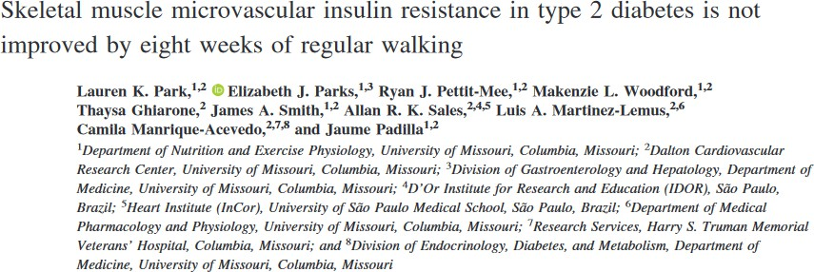
Enter the surname (lastname) of the lead (first) author.
You would enter “Park” for this article

Slide 3
Enter the DOI for the article you are currently reviewing
For the example I would enter: “10.1152/japplphysiol.00174.2020”
Do NOT enter “doi:”

Slide 4
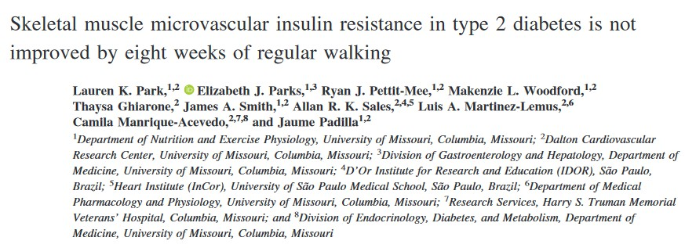
Copy and paste the title of article
Again, easy enough, I would copy and paste title below into this answer box

Slide 5
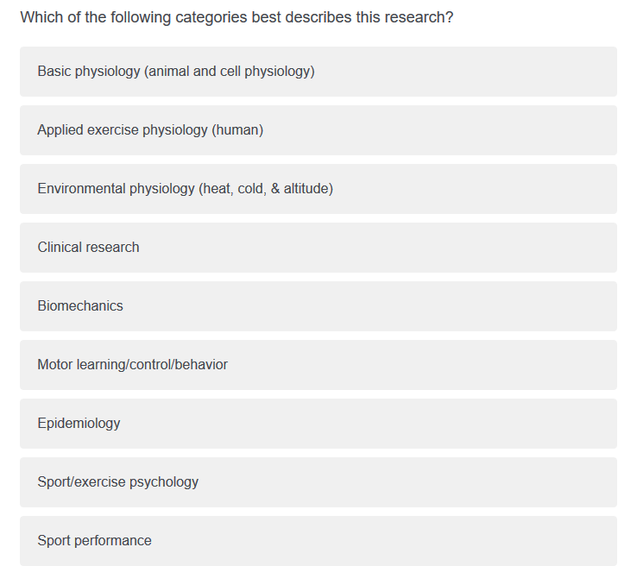
Which of the following categories best describes this research?
For the example, since it is focused on an intervention in humans and physiology, I would select “Applied exercise physiology (human)”

Slide 6
Now go through and briefly skim the article
Optional, but this step may make future steps easier
Look for details in the introduction and discussion for details regarding hypotheses and methods utilized.
Check for words like “hypothesis” and “prediction” in the last paragraph of
the introduction and the first paragraph of the discussion

Slide 7
“According to the authors, is this study a replication of previous work?”
Look for language in the introduction that this work was intended to directly, or indirectly, replicate previous work
E.g., “This study will attempt to replicate the work of Smith et al. 1992”
If no language in the manuscript indicates this
intention then answer “No”
For the example, the answer is no

Slide 8
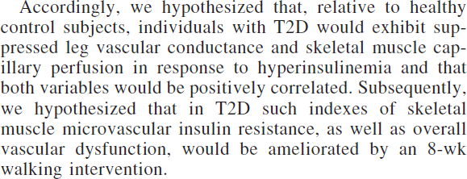
Does this study involve testing a hypothesis? E.g., "We hypothesized that..." or "We predicted that..."
Check the discussion or introduction for language that a hypothesis was tested
For the example, the answer
is “yes”

Slide 9
“How many hypotheses were stated in the manuscript”?
In this example, there are 2 specific hypothesis statements stated so I would select 2 on the survey

Slide 10
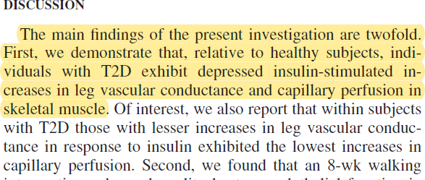
Does the study find support for the hypothesis?
Now we would check the results/discussion to see if the authors believe they have found support for their *first* stated hypothesis
In the example we should answer
“Yes”
And we would answer the next
question as “Full support”
If the authors are extremely ambiguous or fail to state whether or not the hypothesis is supported state “Unclear or not stated”

Slide 11
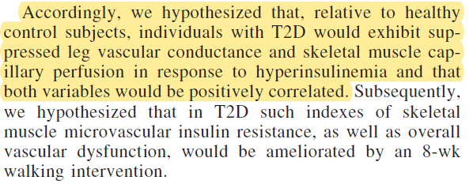
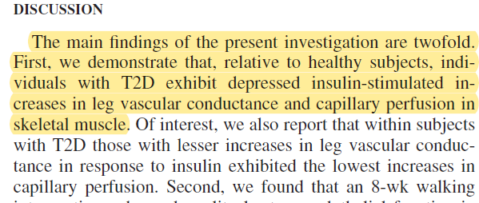
Copy and paste language
stating hypothesis…
The top image is the stated hypothesis and the bottom image is the result of the hypothesis

Slide 12
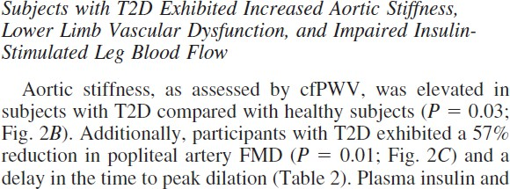
Is any effect size reported? This includes, but is not limited to: Cohen's d, correlation coefficients, mean differences, odds ratio, and measures of model fit (R^2). This does not include descriptive statistics of the sample (e.g., participant age, weight, or other characteristics).
If the study reports some form of effect size, this includes, but is not limited to: Cohen's d, correlation coefficients, mean differences, odds ratio, and measures of model fit (R^2), answer “Yes”
For the example, I would answer “Yes” since percentage changes are reported

Slide 13
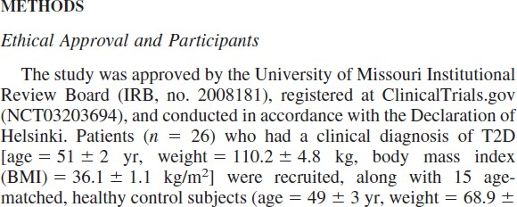
“Does this study/manuscript include information regarding the preregistration or clinical trial registration? This should include an external link or a clinical trial registration number”
Scan the methods section to see if the study has information regarding preregistration and/or clinical trial registration
The “NCT03203694” would be the registration in the example
But could also appear as a link to a website like OSF (Open Science Framework)

Slide 14
“Does this manuscript provide a statement describing if and where study data are available?”
This information is likely included in the Methods section or at the end of the article as additional information.
In the example article, this information is not
included, so we would answer “No”
If this information was included we would then answer a question related to if the data or data supplements are available
So long as there is a link leading to external data/code supplements you would answer “yes” so long as it is accessible (i.e., not behind a paywall)

Slide 15
Did the authors include any language related to statistical significance? E.g., "there was significant correlation between X and Y" or "significance was considered at a p < .05"
This will be tricky for complicated composite hypotheses (like in the example)
For the example we would answer “yes” since the p- values appear to be used as a significance test

Slide 16
Significant p-values
You will have 2-3 question about p-values
1) whether p-values were reported
2) whether they were interpreted as significant
3) were exact or relative (or a mix) p-values were reported
For the example we would answer “Yes”, “Yes” and “exact”
Relative would be if they reported “p < .05” or some kind

Slide 17
Non-Significant p-values
Do authors accept the null hypothesis based on failure to reject the null hypothesis. In other word, do they interpret an absence of significance as an absence of effect.

Slide 18
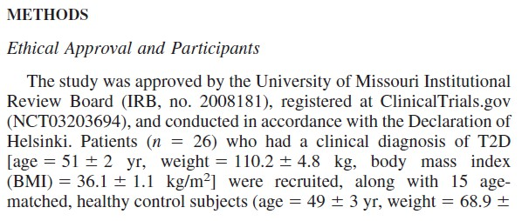
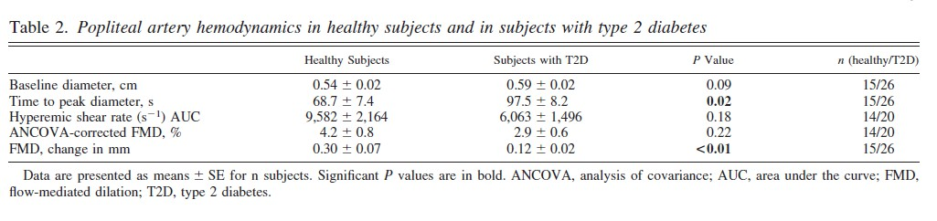
“Does the study/manuscript include information about the sample size”
Again, you should only have to check the methods section where it should be directly stated
As we see, both the total and individual group numbers are available.
Some studies may not have groups so
The next question will have you enter the total sample size
Does the manuscript specify the number of women/females and men/males?

Slide 19

“Was a justification of sample size (e.g., power analysis) included in the manuscript?”
Look in the Methods section to see if they included a reason/justification for the sample size.
In the example there was no mention of power analysis or how the concluded on their final sample size
A justification could be as simple as “A previous study had a sample size of 12 which we found sufficient”.
Type of justification: SESOI, previous studies, pilot studies, benchmark

Slide 20

“Was the article preprinted?”
Look for “preprint” or “pre-print” in the article.
Copy-paste the title in google scholar and check whether
one of the versions is a preprint

